Slide 1
Characterising Network Traffic
6CS029 Advanced Networking

Slide 2
The Need to Scale the Network
Organizations increasingly rely on their network infrastructure to provide mission-critical services.
Evolving organizations require networks that can scale and support:
Converged network traffic
Critical applications
Diverse business needs
Centralized administrative control
Network designs include small networks that use a single LAN switch, up to very large networks with thousands of connections.
B
Notes:
Our digital world has changed. The ability to access the internet and the corporate network is no longer confined to physical offices, geographical locations, or time zones. In today’s globalized workplace, employees can access resources from anywhere in the world and information must be available at any time, and on any device. These requirements drive the need to build next-generation networks that are secure, reliable, and highly available.
These next-generation networks must not only support current expectations and equipment but must also be able to integrate legacy platforms. Businesses increasingly rely on their network infrastructure to provide mission-critical services. As businesses grow and evolve, they hire more employees, open branch offices, and expand into global markets. These changes directly affect the requirements of a network which must be able to scale to meet the needs of business.

Slide 3
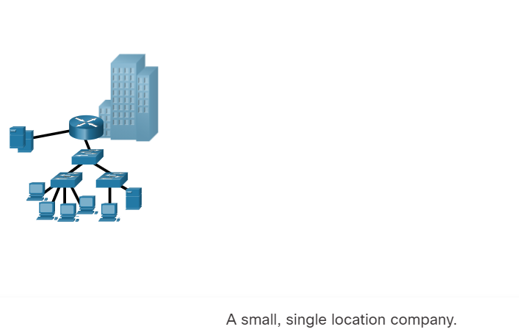
The Need to Scale the Network
Networks evolve with the company's evolution

Slide 4
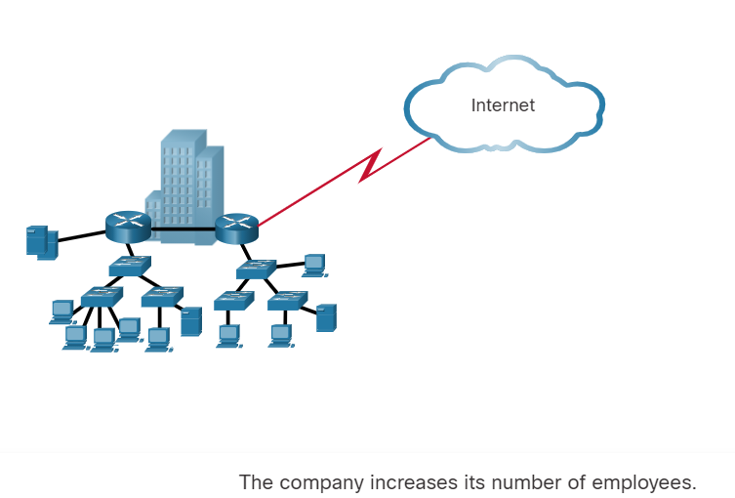

Slide 5
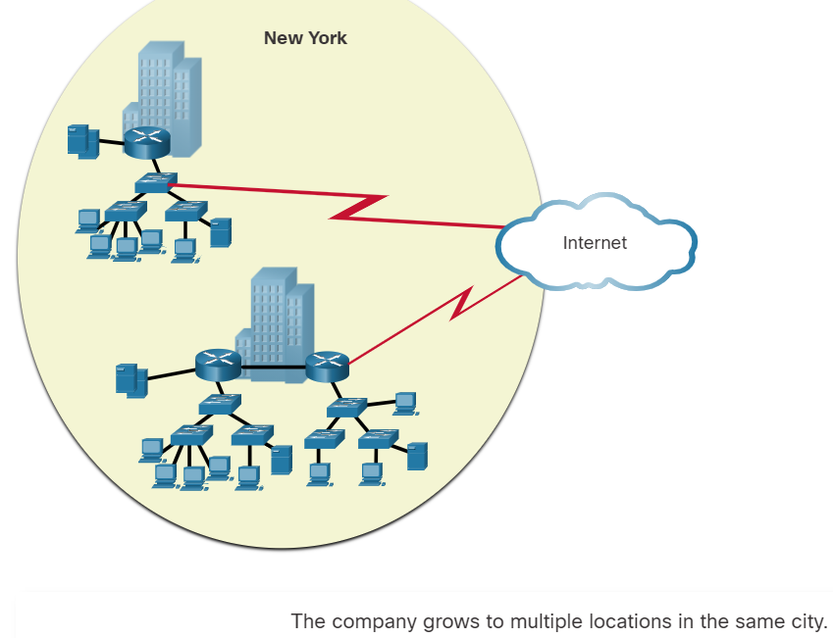

Slide 6
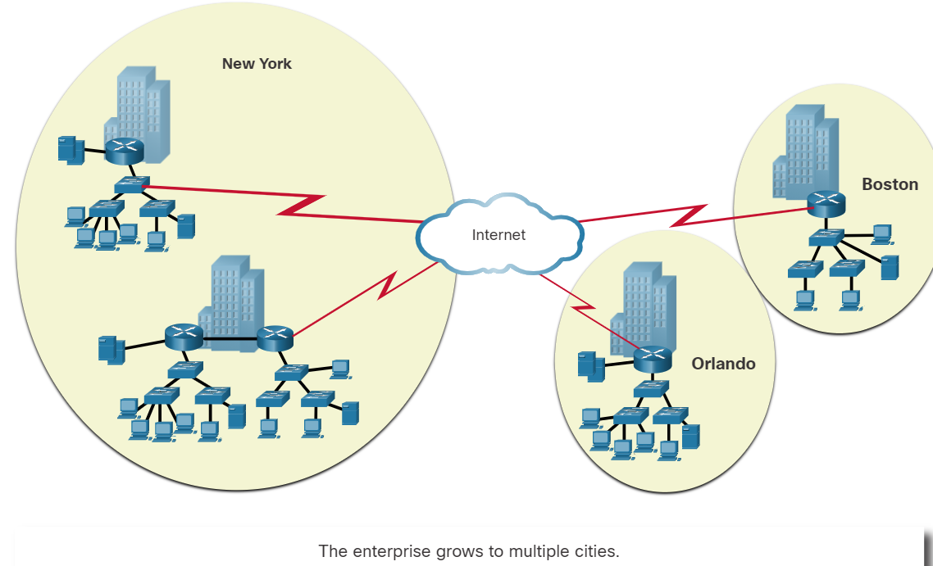

Slide 7
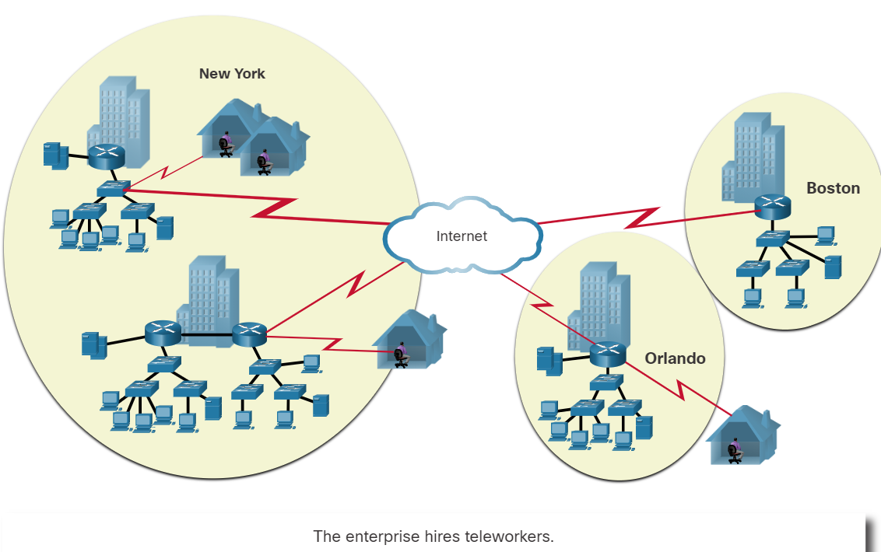
Notes:
Or covid happens and ways of working change forever

Slide 8
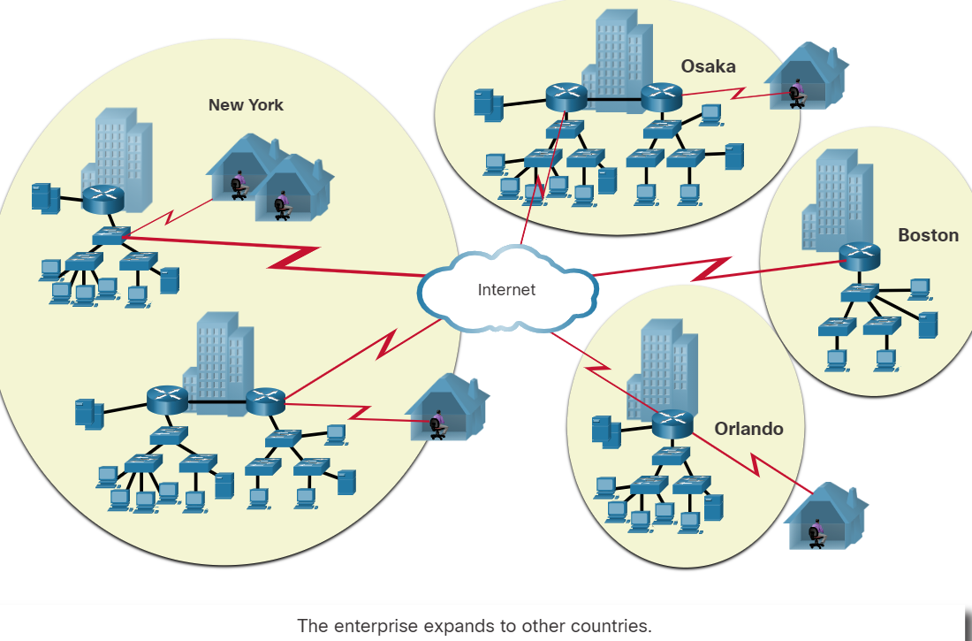

Slide 9

Existing Network
What’s the Starting Point?
“If we could first know where we are and whither we are tending, we could better judge what to do and how to do it.”
Abraham Lincoln

Slide 10
Existing Network
How do we evaluate the health of the existing network?
Performance
Availability
Bandwidth utilization
Efficiency
Response time
Status of major routers, switches, firewalls, servers

Slide 11
Characterising Network Traffic
Understand how network users interact with network resources and services
Are particular groups using particular servers and resources
Where are they located
Identify all user groups
Assess the impact of adding new user groups

Slide 12
Characterising Network Traffic
What are the most important traffic factors to be taken into consideration?
Traffic flow
Location of traffic sources and data stores – e.g. Canvas is in the cloud, where is Panopto stored
Traffic load – load on bandwidth
Traffic behaviour – is it bursty or steady etc
Quality of Service (QoS) requirements VOIP, Teams or Download

Slide 13
User Communities
User Community Name | Size of Community (Number of Users) | Location(s) of Community | Application(s) Used by Community
Students
Academic
Admin

Slide 14
Data Stores
Data Store | Location | Applications | Used by User Communities
Mi Linux
MX building
Students and staff

Slide 15
Traffic Flow
 | Destination 1 MB/sec | Destination 2 MB/sec | Destination 3 MB/sec | Destination n MB/sec
Source 1
Source 2
Source 3
Source n

Slide 16
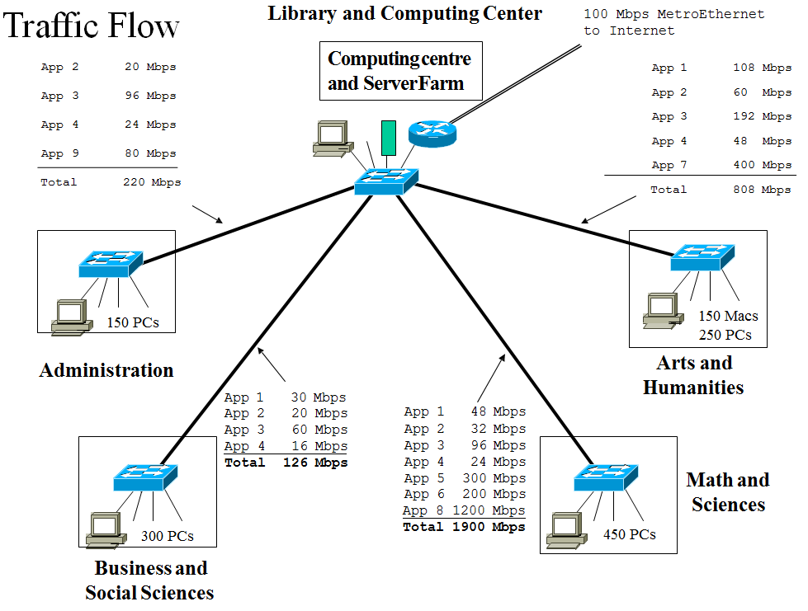

Slide 17
Types of Traffic Flow
Terminal/host – telnet/ SSH is asymmetric
Client/server
Thin client - desktop interacting with the cloud
Peer-to-peer - VOIP
Server/server – DB synchronisation
Distributed computing – Webservices, Finance requires lots of data processing
Notes:
Terminal/Host Traffic Flow
Terminal/host traffic is usually asymmetric. The terminal sends a few characters and the host sends many characters. Telnet/SSH is an example of an application that generates terminal/host traffic. The default behavior for Telnet is that the terminal sends in a single packet each character a user types. The host returns multiple characters, depending on what the user typed. As an illustration, consider the beginning of a Telnet session that starts with the user typing a username. Once the host receives each packet for the characters in the name, the host sends back a message (such as Password Required) in one packet.

Slide 18
QoS Requirements
What makes traffic flow in voice over IP networks challenging to characterise and plan for?
The flow associated with transmitting the audio voice is separate from the flows associated with call setup and teardown.
The flow for transmitting the digital voice is essentially peer-to-peer.
Call setup and teardown is a client/server flow
Jitter and delay
QoS requirements for multimedia traffic

Slide 19
Network Applications
Traffic Characteristics
Name of Application | Type of Traffic Flow | Protocols Used by Application | User Communities That Use the Application | Data Stores (Servers, Hosts, etc) | Approximate Bandwidth Requirements | QoS Requirements
Panopto | streaming | UDP. HTTP | Students | Servers | 100MB | Low jitter and delay

Slide 20
Traffic Load
Required capacity
The number of stations
The average time that a station is idle between sending frames
The time required to transmit a message once medium access is gained
Traffic behaviour
Broadcasts – consumes a lot of BW
Multicasts

Slide 21
What are the bandwidth requirements given this data usage
Endpoint Type | Number of endpoints | % headroom requirements for future | Simultaneous use factor | Bandwidth per endpoint type (Mbps)
Soft phone | 40 | 30% | 60% | 0.1
Hard Phone | 80 | 10% | 50% | 0.1
Two Party HD Video call | 15 | 30% | 60% | 2
Mobile Phone on WiFi | 8 | 10% | 80% | 0.1
3.12
5.28
23.24
0.704
32.504
The Total Site Bandwidth due to Wolves Cloud Office traffic, TS-AV-BW is calculated as the sum of the Endpoint Type Total Bandwidth numbers:
TS-AV-BW = [(Number of Endpoints) + (Headroom for Growth)] x (Simultaneous Use Factor) x (Bandwidth per Endpoint)

Slide 22
Typical Bottlenecks?
Shared services (centralised servers etc)
Multi-user applications and databases
Low-speed NICs
Shared LAN segments
Low-bandwidth WAN links – important with the use of the cloud
Core routing and switching components
Firewalls (particularly public-facing) – incoming traffic inspected
Inappropriate compression usage

Slide 23
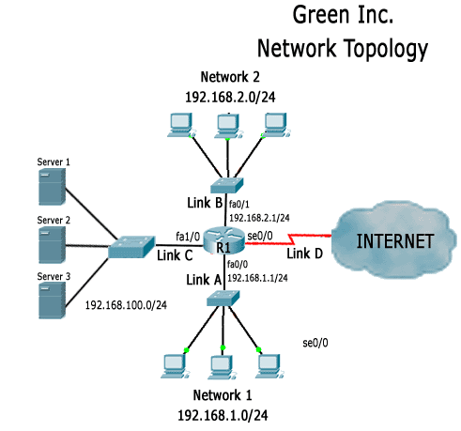
Green Inc. is expanding and just got another floor on the building they have their main office. The new floor will also need to be connected to Green’s network.
Within Green Inc. Network, network 1 users need to frequently access a database stored in Server 1.
Network 2 users also frequently access a database stored in Server 2.
Bottleneck and failure weakness
Task1: Identify performance, scalability and redundancy problems with this network design.

Slide 24
Green Inc. is expanding and just got another floor on the building they have their main office. The new floor will also need to be connected to Green’s network.
Within Green Inc. Network, network 1 users need to frequently access a database stored in Server 1.
Network 2 users also frequently access a database stored in Server 2.
Task2: Propose a new network design to solve the problems identified

Slide 25
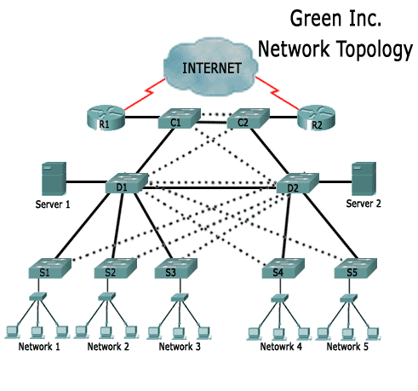

Slide 26
Borderless Switched Networks
A network architecture that can connect anyone, anywhere, anytime, on any device; securely, reliably, and seamlessly.
It provides the framework to unify wired and wireless access, built on a hierarchical infrastructure of hardware that is scalable and resilient.
Borderless switched networks are hierarchical, modular, resilient, and flexible.
Notes:
With the increasing demands of the converged network, the network must be developed with an architectural approach that embeds intelligence, simplifies operations, and is scalable to meet future demands. One of the more recent developments in network design is the Cisco Borderless Network.
The Cisco Borderless Network is a network architecture that combines innovation and design. It allows organizations to support a borderless network that can connect anyone, anywhere, anytime, on any device; securely, reliably, and seamlessly. This architecture is designed to address IT and business challenges, such as supporting the converged network and changing work patterns.
The Cisco Borderless Network provides the framework to unify wired and wireless access, including policy, access control, and performance management across many different device types. Using this architecture, the borderless network, shown in the figure, is built on a hierarchical infrastructure of hardware that is scalable and resilient.
By combining this hardware infrastructure with policy-based software solutions, the Cisco Borderless Network provides two primary sets of services: network services, and user and endpoint services under the umbrella of an integrated management solution. It enables different network elements to work together, and allows users to access resources from any place, at any time, while providing optimization, scalability, and security.
Creating a borderless switched network requires that sound network design principles are used to ensure maximum availability, flexibility, security, and manageability. The borderless switched network must deliver on current requirements and future required services and technologies. Borderless switched network design guidelines are built upon the following principles:
Hierarchical - The design facilitates understanding the role of each device at every tier, simplifies deployment, operation, and management, and reduces fault domains at every tier.
Modularity - The design allows seamless network expansion and integrated service enablement on an on-demand basis.
Resiliency - The design satisfies user expectations for keeping the network always on.
Flexibility - The design allows intelligent traffic load sharing by using all network resources.
These are not independent principles. Understanding how each principle fits in the context of the others is critical. Designing a borderless switched network in a hierarchical fashion creates a foundation that allows network designers to overlay security, mobility, and unified communication features. Two time-tested and proven hierarchical design frameworks for campus networks are the three-tier layer and the two-tier layer models.
The three critical layers within these tiered designs are the access, distribution, and core layers. Each layer can be seen as a well-defined, structured module with specific roles and functions in the campus network. Introducing modularity into the campus hierarchical design further ensures that the campus network remains resilient and flexible enough to provide critical network services. Modularity also helps to allow for growth and changes that occur over time.

Slide 27
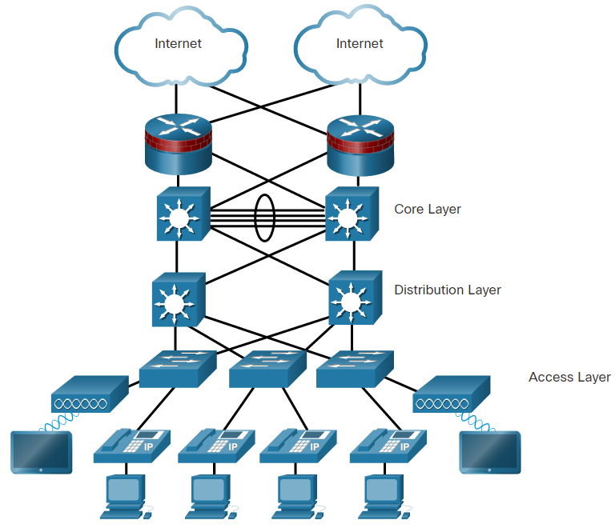
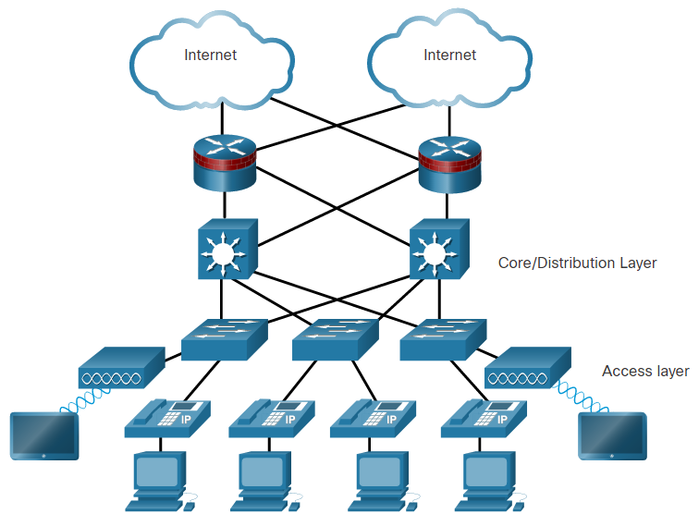
Hierarchy in the Borderless Switched Network
Hierarchical networks use a tiered design of access, distribution, and core layers with each layer performing a well-defined role in the campus network.
Three-tier layer
Two-tier layer
Core – high speed data transfer – minimal filtering
DS may use layer 3 switches – applies security policies and traffic flow
Access layer – user end
Notes:
There are two time-tested and proven hierarchical design frameworks for campus networks.

Slide 28
Access, Distribution, and Core Layer Functions
Access Layer
The access layer provide network access to the user.
Access layer switches connect to distribution layer switches.
Distribution Layer
The distribution layer implements routing, quality of service, and security.
It aggregates large-scale wiring closet networks and limits Layer 2 broadcast domains.
Distribution layer switches connect to access layer and core layer switches.
Core Layer
The core layer is the network backbone and connects several layers of the network.
The core layer provides fault isolation and high-speed backbone connectivity.
Notes:
11 – Network Design
11.1 – Hierarchical Networks
11.1.5 – Access, Distribution, and Core Layer Functions

Slide 29
Advantages of Hierarchical Network Design
Scalability
Easier to add to the network
Manageability
Easier to identify location of problems because network is segmented
Broadcast traffic segmentation
Traffic confined to smaller broadcast domains
Less traffic over expensive links

Slide 30
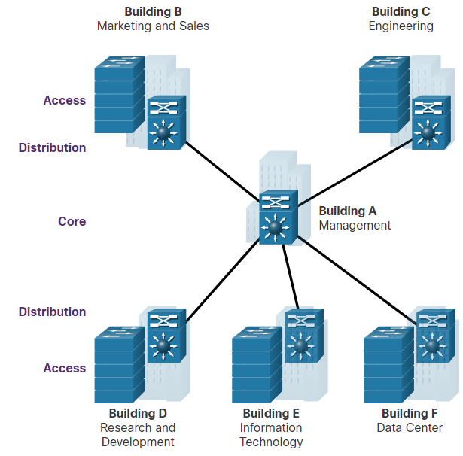
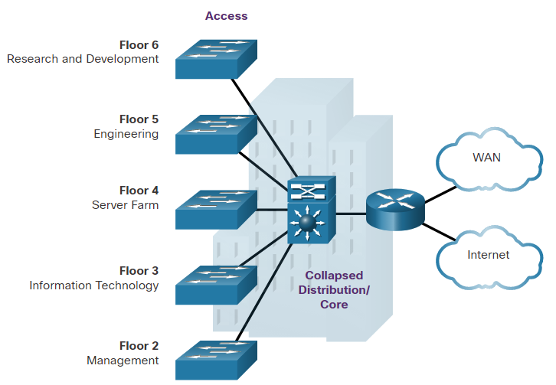
Three-Tier and Two-Tier Examples
Three-tier Campus Network
Used by organizations requiring access, distribution, and core layers.
The recommendation is to build an extended-star physical network topology from a centralized building location to all other buildings on the same campus.
Two-tier Campus Network
Used when separate distribution and core layers is not required.
Useful for smaller campus locations, or in campus sites consisting of a single building.
Also known as the collapsed core network design.

Slide 31
Design for Scalability
Scalability is the term for a network that can grow without losing availability and reliability.
Network designers must develop strategies to enable the network to be available and to scale effectively and easily.
This is accomplished using:
Redundancy
Multiple Links
Scalable Routing protocol
Wireless Connectivity
Notes:
11 – Network Design
11.2 – Scalable Networks
11.2.1 – Design for Scalability

Slide 32
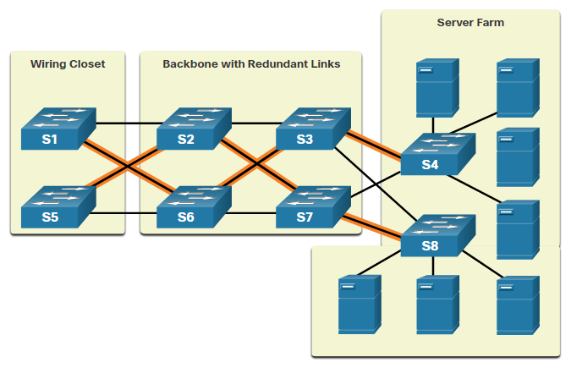
Plan for Redundancy
Redundancy can prevent disruption of network services by minimizing the possibility of a single point of failure by:
Installing duplicate equipment
Providing failover services for critical devices
Redundant paths offer alternate physical paths for data to traverse the network supporting high availability.
However, redundant paths in an Ethernet network may cause logical Layer 2 loops.
Therefore, Spanning Tree Protocol (STP) is required.
Notes:
11 – Network Design
11.2 – Scalable Networks
11.2.2 – Plan for Redundancy

Slide 33
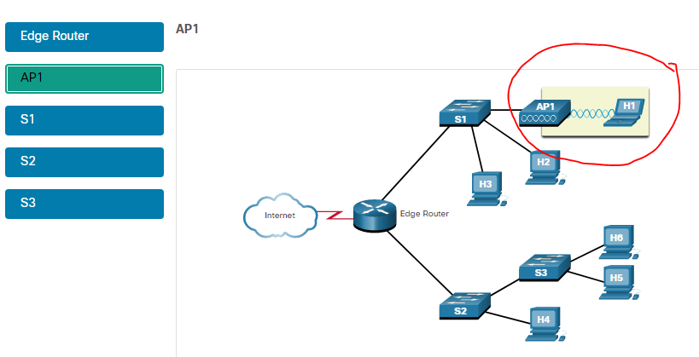
Reduce Failure Domain Size

Slide 34
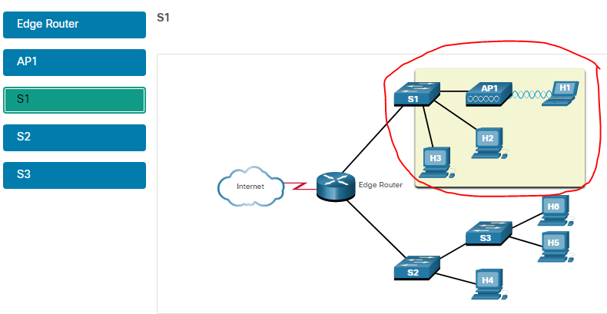

Slide 35
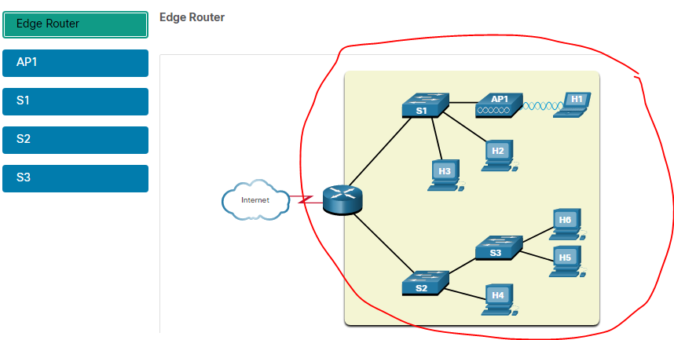

Slide 36
Reduce Failure Domain Size
A well-designed network controls traffic and limits the size of failure domains (i.e., the area of a network that is impacted when the network experiences problems).
In the hierarchical design model, failure domains are terminated at the distribution layer.
Every router functions as a gateway for a limited number of access layer users.
Routers, or multilayer switches, are usually deployed in pairs in a configuration referred to as a building, or departmental, switch block.
Each switch block acts independently of the others.
As a result, the failure of a single device does not cause the network to go down.
Notes:
Because a failure at the core layer of a network can have a potentially large impact, the network designer often concentrates on efforts to prevent failures. These efforts can greatly increase the cost of implementing the network. In the hierarchical design model, it is easiest and usually least expensive to control the size of a failure domain in the distribution layer. In the distribution layer, network errors can be contained to a smaller area; thus, affecting fewer users. When using Layer 3 devices at the distribution layer, every router functions as a gateway for a limited number of access layer users.
Switch Block Deployment
Routers, or multilayer switches, are usually deployed in pairs, with access layer switches evenly divided between them. This configuration is referred to as a building, or departmental, switch block. Each switch block acts independently of the others. As a result, the failure of a single device does not cause the network to go down. Even the failure of an entire switch block does not affect a significant number of end users.

Slide 37
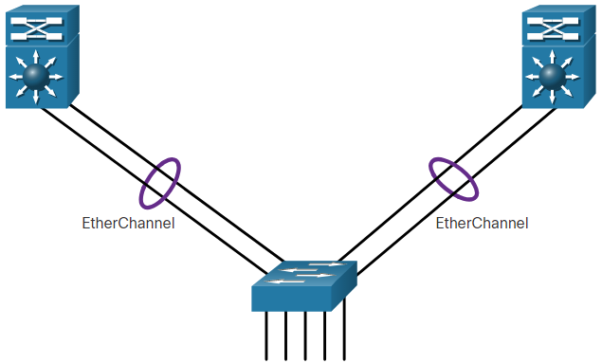
Increase Bandwidth
Link aggregation (e.g., EtherChannel) allows an administrator to increase the amount of bandwidth between devices by creating one logical link made up of several physical links.
EtherChannel combines existing switch ports into one logical link using a Port Channel interface.
Most configuration tasks are done on the Port Channel interface (instead of on each individual port) to ensure configuration consistency on the links.
EtherChannel can load balance between links.

Slide 38
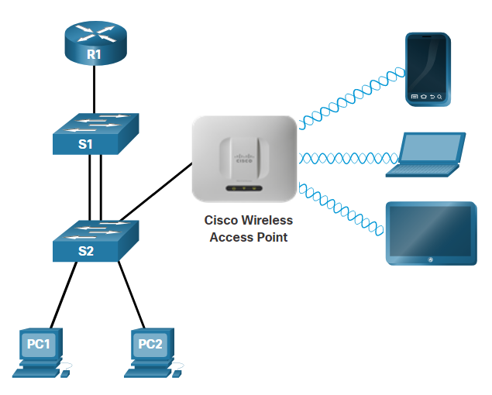
Expand the Access Layer
An increasingly popular option for extending access layer connectivity is through wireless.
Wireless LANs (WLANs) provides increased flexibility, reduced costs, and the ability to grow and adapt to changing network and business requirements.
To communicate wirelessly, end devices require a wireless NIC to connect to a wireless router or a wireless access point (AP).
Considerations when implementing a wireless network include:
Types of wireless devices connecting to the WLAN
Wireless coverage requirements
Interference considerations
Security considerations

Slide 39
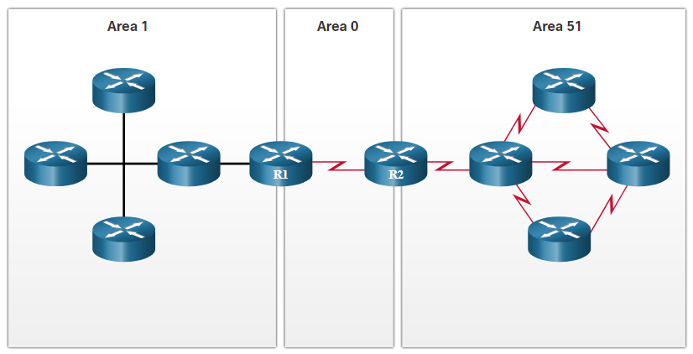
Tune Routing Protocols
Advanced routing protocols, such as Open Shortest Path First (OSPF) are used in large networks.
OSPF is a link-state routing protocol that uses areas to support hierarchical networks.
OSPF routers establish and maintain neighbor adjacencies with other connected OSPF routers.
OSPF routers synchronize their link-state database.
When a network change occurs, link-state updates are sent, informing other OSPF routers of the change and establishing a new best path, if one is available.

Slide 40
Multilayer Switching
Multilayer switches are typically deployed in the core and distribution layers of an organization's switched network.
They support some routing protocols and forward IP packets at a rate close to that of Layer 2 forwarding.
Multilayer switches often support specialized hardware, such as application-specific integrated circuits (ASICs).
ASICs along with dedicated software data structures can streamline the forwarding of IP packets independent of the CPU.

Slide 41
VLANs
Logical hierarchy imposed on a flat switched network allowing
Scalability
Formation of workgroups
Simplified admin
Better security

Slide 42
Summary
Understand network traffic in terms of:
Flow
Load
Behavior
QoS requirements

Slide 43
Questions?

